Slide 1
7 Trends Shaping the Next Generation of Learning

Slide 2
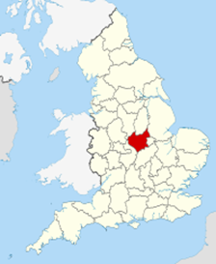


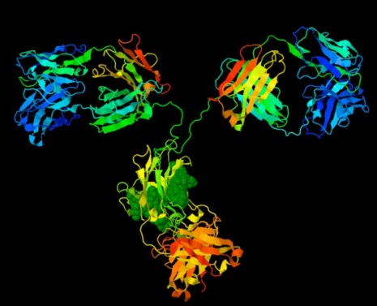

Slide 3
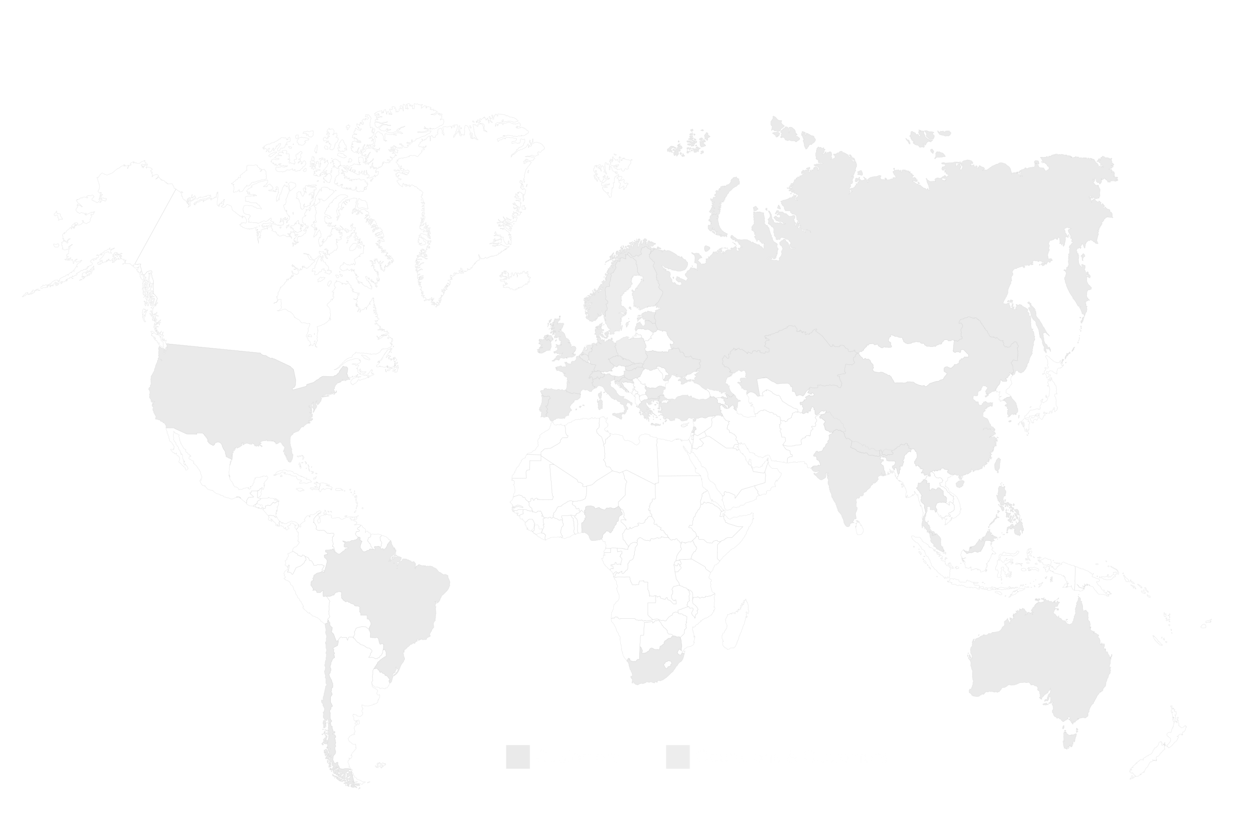
1,500 professionals
passionate about education

Slide 4
Serving 10 M pupils
and 1 M teachers
in Northern Europe

Slide 5
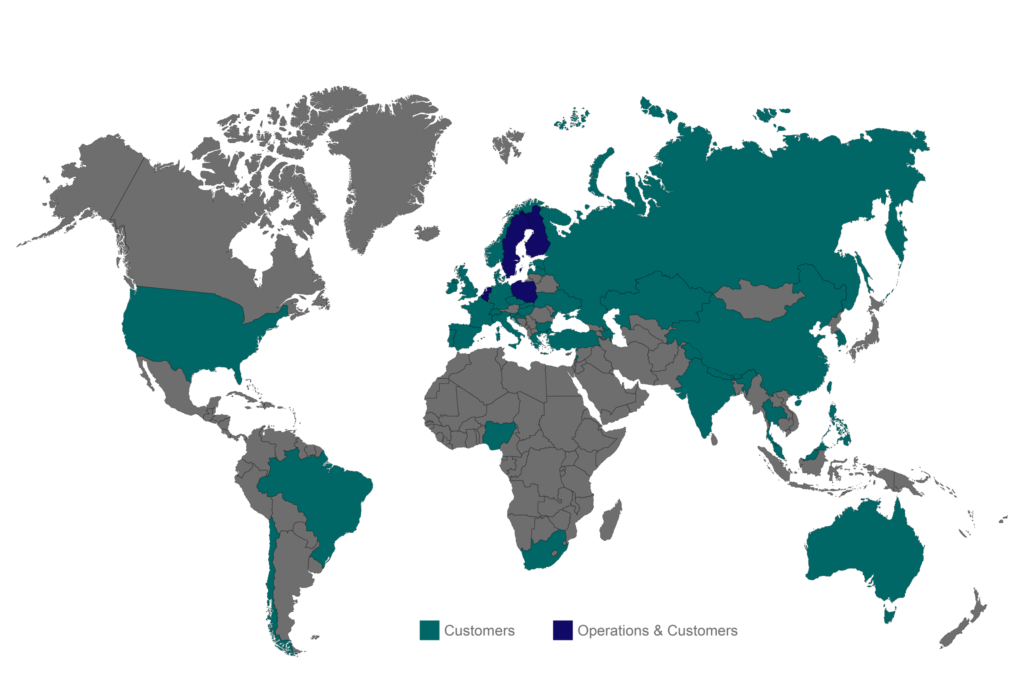
Integral provider in 5 countries
Customers > 40 countries

Slide 6
€ 300 M sales
€ 40 M pure-play digital
€ 100 M multi-channel

Slide 7
We believe that
skilled teachers,
motivated pupils and
high-quality learning materials
are the cornerstones of excellent education

Slide 8
We see 7 trends
that are shaping
the next generation
of learning

Slide 9

1. from inputs
to …

Slide 10

1. from inputs
to outcomes

Slide 11

2. from mass to …

Slide 12

2. from mass
to personal

Slide 13

3. from workload to …

Slide 14

3. from workload
to workflow

Slide 15

4. from analogue to …

Slide 16

4. from analogue
to digital

Slide 17

5. from data to …

Slide 18

5. from data
to insight

Slide 19

6. from classroom to …

Slide 20

6. from classroom to borderless

Slide 21

7. from scarcity to …

Slide 22

7. from scarcity
to abundance

Slide 23
It’s time to embrace these changes
and invest in renewing education

Slide 24
Our mission is to support pupils
and teachers on 3 fronts
✔ Excellent outcomes
✔ Workflow efficiency
✔ Engaged learning

Slide 25
Sanoma Learning
Outcomes Accelerator
How are we going to improve and evidence
the impact of education
in the new era?
sanomalearningoutcomes.com

Slide 26
@johnrichmartin

